Slide 1
Red, White, Blue, and ...Green?
Using Census income and other data to predict future state voting
By William Beedle

Slide 2
What is the point?
After the last election, both sides of the political aisle were surprised by how off the polls were about how close the states were
Many people even have begun to wonder if the polls are worth listening to
Help others develop a better understanding on how external factors may affect a state’s voting pattern

Slide 3


The Data
Median Income data came from US Census
1984 - 2019
51 rows for each state and the United States as a whole and 36 columns
State Votes’ came from Harvard Dataverse
1976-2016
13 columns and 3740 rows
Data is adjusted for inflation

Slide 4
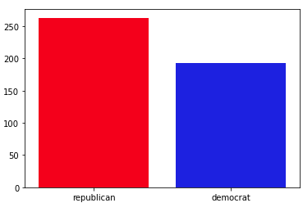
Data Distribution

Slide 5

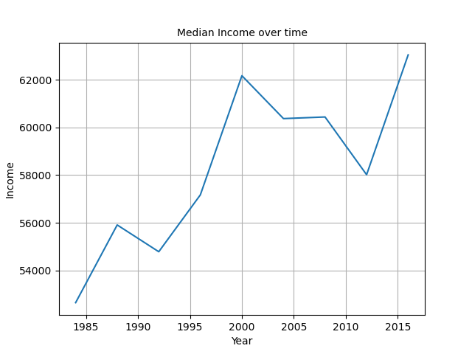
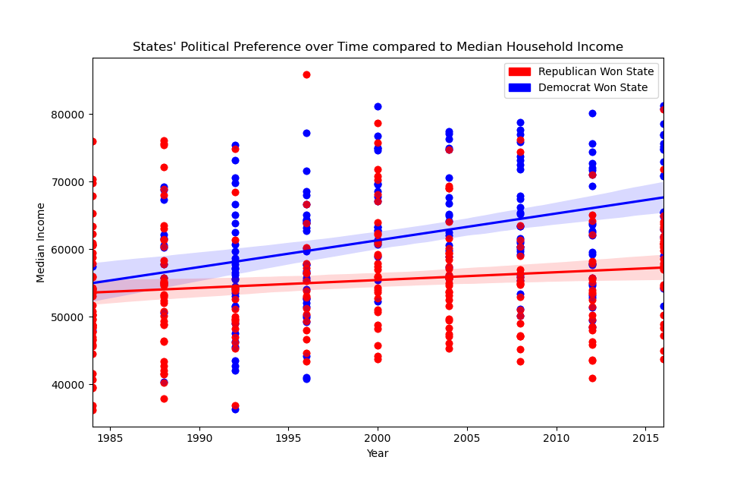
Median Income Change Overall

Slide 6
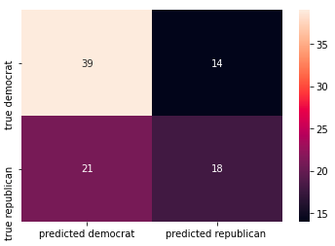
Random Forest
Accuracy = .56
Precision = .64
Recall = .82

Slide 7
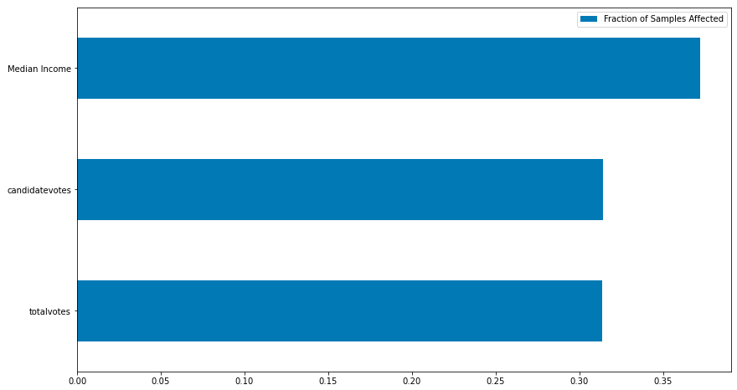
Feature Importance

Slide 8
Expand scope to use county data
Next Steps?
Shift to multiple unsupervised models
Turn into web application

Slide 9
Thank you!

